Slide 1


Curriculum Integration
Connecting Learning Across Disciplines
Apply knowledge of content within and across curriculum teaching areas (1.1.2)
DAY 1
Notes:
Welcome participants and introduce the purpose of curriculum integration—enhancing relevance and engagement by linking subjects through authentic contexts.

Slide 2






MISSION
DAM (Dream Achieve More) Training Consultancy Services is committed to:
To deliver quality-assured training and consultancy services anchored on Total Quality Management principles, promoting continuous improvement, customer satisfaction, and professional excellence among educators and professionals.
MISSION & VISION
VISION
To be a leading provider of total quality driven training programs that impower professionals to Dream, Achieve and do More in their fields, driving collective success and sustainable progress.
DREAM, ACHIEVE MORE----TRAINING CONSULTANCY SERVICES

Slide 3
Session Objectives (PPST-Aligned)
- Understand the concept and importance of curriculum integration.
- Identify strategies for designing integrative lessons.
- Apply integration approaches to promote 21st-century learning.
PPST Alignment: Domain 1 – Content Knowledge and Pedagogy; Domain 3 – Diversity of Learners.
Notes:
Explain how these objectives align with PPST indicators related to pedagogy and learner-centered approaches.

Slide 4




With K to 12, we will..
Produce holistically developed learners who have 21st century skills and are prepared for higher education, middle-level skills development, employment, and entrepreneurship.
“..country with an organized and shared rapid expansion of our economy through a government dedicated in honing and mobilizing our people’s skills and energies..”
-Philippine Development Plan 2011-2016
Notes:
With the K to 12 Program, we aim to fundamentally transform our basic education curriculum so that it produces holistically developed learners who have 21st century skills and are prepared for higher education, middle-level skills development, employment, and entrepreneurship. K to 12 is a joint program of the Department of Education, the Commission on Higher Education, and the Technical Education and Skills Development Authority. Beyond the three education agencies, the program is being developed in concert with all relevant stakeholders: students, parents, teachers and administrators from public and private schools, education experts, government agencies and the legislature, higher education institutions, business sector and industries, and civil society organizations.
K to 12 is our collective response to the challenge of making basic education work for all learners.

Slide 5
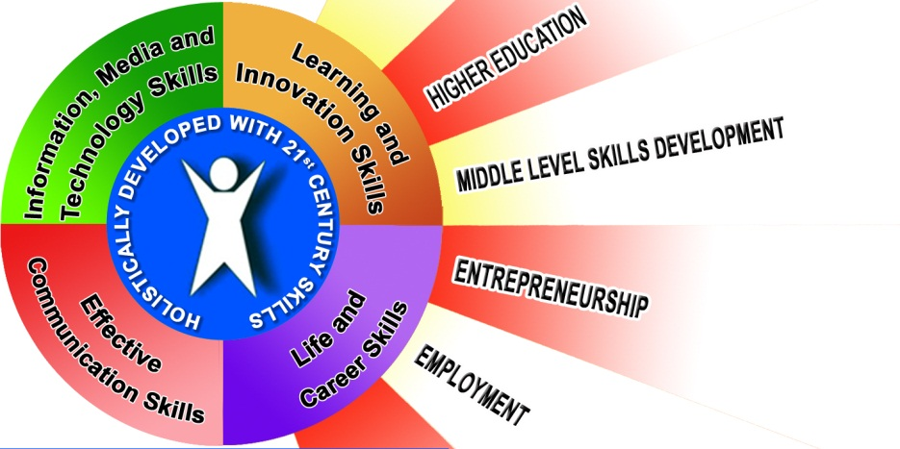

Slide 6
The K to 12 Basic Education Curriculum is enhanced.
Integrative, Inquiry-based, Constructivist, Technology-enhanced
Learner-Centered
Deconges-ted
Seamless
Respon-sive
Enriched
Focuses on the optimum development of the Filipino
Allows for mastery of competencies
Flexible to local needs
Continuum following an expanding spiral progression model
Notes:
The K to 12 curriculum is learner-centered and focused on the holistically developed Filipino. The topics are also developmentally appropriate (age appropriate).
It will be decongested to allow for mastery of competencies.
It is seamless. The content, content and performance standards, and competencies are in a continuum following the spiral progression model. There are no gaps or overlaps. It observes vertical alignment of content and performance standards, competencies and assessment across grade levels. It also supports horizontal alignment of content and performance standards and competencies between and among learning areas.
Skills like “reading graphs” will be taught in Math before this is used in Science, Health and Economics topics.
Trigonometric concepts will be taught before vectors are discussed in physics.
The science concepts introduced in K are reinforced by the integration of science concepts in Grades 2 and 3.
The curriculum will allow flexibility to be responsive to the needs of the community. An agricultural town may offer agricultural electives for instance. Coastal areas may offer fishery electives, urban areas on industrial arts. This will also be systematically matched with labor market studies.
The curriculum will be integrative. It addresses diverse curricular concerns (e.g. human rights, media and information literacy, climate change, sustainable development) through integration to avoid the congestion of the curriculum. It will also be inquiry-based. The curriculum ensures that the learners have the opportunity develop skills of creative and critical thinking, informed decision-making, hypothesis-building and problem-solving. The curriculum will be constructivist – learners construct their own knowledge and understanding out of their experiences. Lastly, the curriculum will be enriched through the use of appropriate technologies including ICT.

Slide 7
What is Curriculum Integration?
A teaching approach that links learning experiences across subject areas around meaningful themes or problems.
Notes:
Provide simple examples, e.g., linking Math (budgeting) and English (proposal writing).

Slide 8
Rationale for Integration
- Makes learning relevant and engaging.
- Encourages critical and creative thinking.
- Reflects real-life situations where knowledge areas intersect.
Notes:
Discuss how integrated curriculum supports whole-child development.

Slide 9
PPST Connection
Domain 1.1: Demonstrates mastery of content and its interrelationships.
Domain 4.2: Uses a range of teaching strategies that enhance learning.
Notes:
Show that integration promotes holistic teaching practice under PPST.

Slide 10
Models of Curriculum Integration
- Multidisciplinary
- Interdisciplinary
- Transdisciplinary
Notes:
Explain differences; show classroom examples for each model.

Slide 11
Models of Curriculum Integration
- Multidisciplinary
Kahulugan: Maraming asignatura (subjects) ang ginagamit, pero hiwalay pa rin ang bawat isa.
Pokus: Bawat asignatura ay may sariling layunin, nilalaman, at paraan ng pagtuturo, kahit na may common theme.
Halimbawa sa bata:
Tema: “Kalikasan”
  Science: Pag-aaral ng mga hayop sa kagubatan
  Math: Pagbibilang ng bilang ng hayop sa larawan
  Art: Gumuhit ng tanawin sa kagubatan
  → Magkakaugnay ang tema pero hiwalay pa rin ang aralin
Notes:
Explain differences; show classroom examples for each model.

Slide 12
Models of Curriculum Integration
- Interdisciplinary
Kahulugan: Pinagsasama ang dalawa o higit pang asignatura sa mas malalim na paraan, may pagkakaugnay at pinagsamang layunin.
Pokus: Nakikita ng bata kung paano nagkakaugnay ang kaalaman mula sa iba’t ibang asignatura.
Halimbawa sa bata:
Tema: “Kalikasan”
  Science + Math: Gumawa ng survey sa klase kung ilan ang may halaman sa bahay at gumuhit ng graph
  Art + Language: Gumawa ng poster at sulat ng maikling kwento tungkol sa kalikasan
  → Hindi lang magkakasabay na aralin, kundi pinagsama para sa iisang layunin
Notes:
Explain differences; show classroom examples for each model.

Slide 13
Models of Curriculum Integration
- Transdisciplinary
Kahulugan: Ang buong pagkatuto ay nakasentro sa aktwal na karanasan o problema sa totoong buhay, hindi na nakabase sa hiwalay na asignatura.
Pokus: Ang bata ay natututo habang ginagamit ang kaalaman mula sa iba’t ibang asignatura nang sabay-sabay.
Halimbawa sa bata:
Tema: “Aking Hardin”
  Lahat ng asignatura ay ginagamit sa pagbuo at pag-aalaga ng maliit na hardin:
    Science: Alamin ang tamang tanim at tubig
    Math: Sukatin ang lupa at bilangin ang halaman
    Language: Gumawa ng journal tungkol sa halaman
    Art: Gumuhit ng hardin
    → Ang aralin ay nakatuon sa totoong proyekto, hindi sa mismong asignatura
Notes:
Explain differences; show classroom examples for each model.

Slide 14
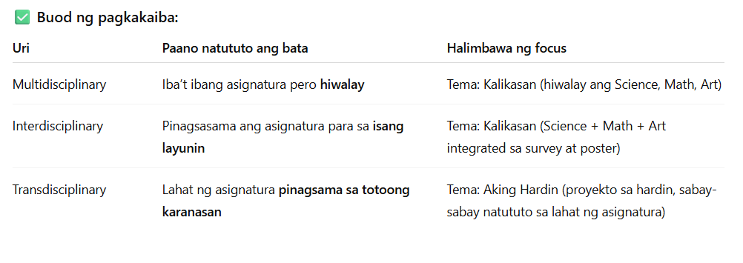
Models of Curriculum Integration
Notes:
Explain differences; show classroom examples for each model.

Slide 15
Integrated Lesson Example
Theme: Sustainability
Subjects: Science (Recycling), Math (Data Collection), English (Persuasive Writing)
Notes:
Discuss how one theme connects multiple disciplines and skills.

Slide 16
Teacher’s Role in Integration
- Designer of connected learning experiences
- Facilitator of inquiry and collaboration
- Assessor of process and product
Notes:
Relate to PPST Domain 2 – Learning Environment.

Slide 17
Strategies for Implementation
- Thematic teaching
- Project-based learning
- Collaborative planning with peers
Notes:
Encourage teachers to co-plan integrative activities.

Slide 18
Strategies for Implementation
1. Thematic Teaching
Kahulugan: Ang pagtuturo ay nakasentro sa isang tema o paksa na pwedeng saklawin ang iba’t ibang asignatura.
Pokus: Tema-based; pinagsasama ang kaalaman sa iba't ibang asignatura sa ilalim ng iisang paksa.
Halimbawa: Tema: “Aking Pamilya”
  Language: Kwento tungkol sa pamilya
  Math: Bilang ng miyembro ng pamilya
  Art: Gumuhit ng portrait ng pamilya
Layunin: Madaling maipakita sa bata ang ugnayan ng kaalaman sa isang tema.
Notes:
Encourage teachers to co-plan integrative activities.

Slide 19
Strategies for Implementation
2. Project-Based Learning (PBL)
Kahulugan: Ang mga bata ay natututo sa pamamagitan ng aktwal na proyekto na may malinaw na layunin at output.
Pokus: Real-world application; natututo habang gumagawa at nagtatapos sa isang konkretong produkto o solusyon.
Halimbawa:
  Proyekto: Gumawa ng mini-garden sa klase
  Activities: Research sa halaman (Science), Sukatin ang lupa at bilang ng tanim (Math), Gumuhit ng garden layout (Art)
Layunin: Pag-develop ng problem-solving skills, collaboration, at critical thinking habang natututo.
Notes:
Encourage teachers to co-plan integrative activities.

Slide 20
Strategies for Implementation
3. Collaborative Planning with Peers
Kahulugan: Ang guro ay nagtutulungan sa ibang guro sa pagpaplano ng leksyon o curriculum.
Pokus: Teacher-focused; mas mahusay na plano dahil pinag-uugnay ang kaalaman, estilo ng pagtuturo, at resources.
Halimbawa:
  Mga guro sa Math at Science ay nagtutulungan para sa isang integrated lesson tungkol sa Kalikasan
  Gumagawa sila ng plan para sabay-sabay matutunan ng mga bata ang Science concepts at Math skills
Layunin: Mas epektibong pagtuturo sa pamamagitan ng pagpaplano at koordinasyon.
Notes:
Encourage teachers to co-plan integrative activities.

Slide 21
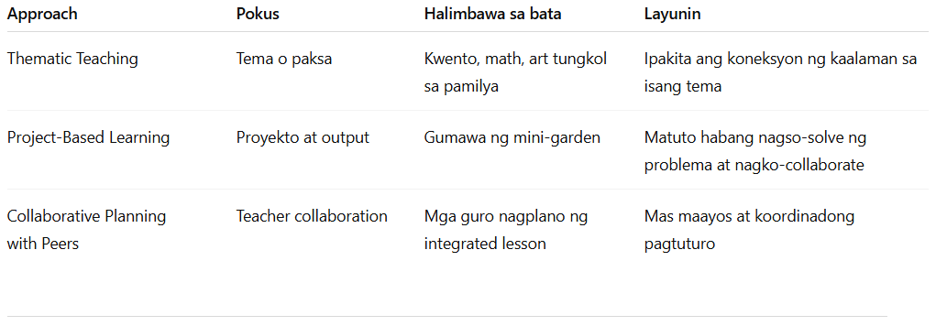
Strategies for Implementation
Notes:
Encourage teachers to co-plan integrative activities.

Slide 22
Challenges in Integration
- Time constraints
- Assessment alignment
- Teacher preparedness
Notes:
Discuss how collaboration and planning can overcome these.

Slide 23
Assessment in Integrated Curriculum
- Performance-based assessment
- Rubrics and portfolios
- Reflective journals
Notes:
Highlight the shift from content recall to authentic assessment.

Slide 24
ICT Integration in Curriculum Design
- Use of digital tools to connect disciplines
- Online collaboration and research
Notes:
Cite PPST Domain 4.5 – Utilizes ICT to enhance learning.

Slide 25
Classroom Example Activity
Activity: 'Design a Community Garden'
Integrated Areas: Science, Math, English, EPP/TLE
Notes:
Use this to illustrate applied integration in Filipino schools.

Slide 26
Teacher Reflection
- How can I make my lessons more connected across disciplines?
- What challenges do I foresee in integration?
Notes:
Allow 3–5 minutes for participants to write reflections.

Slide 27
Application Activity
Task: Design a 1-LESSON PLAN integrative lesson plan aligned with PPST Domains.
Output: Short presentation or visual plan.
Notes:
End with sharing session; emphasize continuous improvement through collaboration.

